Slide 1
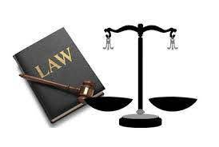
YOU AND THE LAW
BY ARMOGHAN TALLAT KHAN

Slide 2
LEGAL STATUS OF A SECURITY GUARD
What is my legal status under Criminal Code?
The Law say’s that you are protected if,
Act was reasonable
Justified

Slide 3
CHARTER OF RIGHTS AND FREEDOM
What are my rights and freedom?
Right of Free movement.
Right of not being unreasonably searched.

Slide 4
TYPES OF CRIMINAL OFFENSES
What is a criminal offense?
How are offenses classified under Criminal Code?
What is an indictable offense?
What is a summary conviction offense?
What are hybrid offenses?

Slide 5
WHAT CAN I DO IF I THINK THAT SOMEONE AT MY SITE IS INVOLVED IN A CRIME OR HAS INFORMATION ABOUT A CRIME?
If you find some one you can enquire them.
The question must be General.
Like what are you up to.

Slide 6
POWER OF ARRESTS
Do I have the power to arrest someone?
What exactly does “arrest” mean?
So when am I justified in making an arrest?

Slide 7
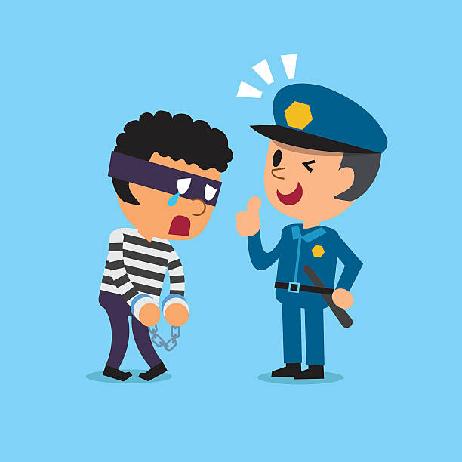
What Procedures must be followed to make an arrest?
MAKING AN ARREST
Identify yourself
Tell them that you are arresting them
The person must understand why you are arresting them
Ask the person to go with you
Tell the person that they can call their lawyer
Turn the person over to the police as soon as possible

Slide 8
WHAT YOU SHOULD SAY WHEN ARRESTING SOMEONE
What to Do
What to Say
Identify Yourself Tell the person
Give the reason
Be sure that person understands
Guide person to private area
Warn the person
Carefully record all the response of that person in writing
I am a security guard for…
You are under arrest for …
The theft of a digital camera
Please come with me
You may call your lawyer
Write the response of person carefully

Slide 9
USE OF FORCE
What can I do to avoid using force?
What you say
What you do
When Can I use force?
How much force can I use?
What is excited delirium?
What can happen to me if I use too much force?

Slide 10
SEARCH AND SEIZURE
When can I search Someone?
When can I seizure something from someone?

Slide 11
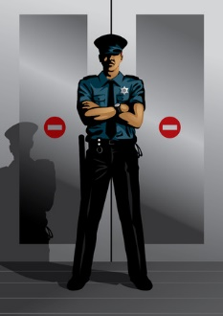
LANDLORDS AND TENANTS
What does this have to do with security guards?
What are my rights and responsibilities?
How should you respond to
Tenants
Clients illegal work

Slide 12
TRESPASSING AND VANDALISM
What is Trespassing and what I can do?
What is vandalism? Can I arrest someone for it?

Slide 13
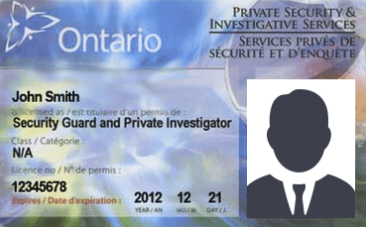
LICENSING OF SECURITY GUARDS
What is license:
Cost of it
From where to
Period of Licence
Do all security guard have there license

